Slide 1

Dashboardcccc
Vehicle Population Analysis
Power BI Data Analytics Project
By Shina Oyeleye

Slide 2
Project Overview
This project analyzes vehicle population statistics across regions to understand transportation patterns, ownership distribution, and usage trends using Power BI.

Slide 3
Project Objectives
• Identify regions with highest and lowest vehicle populations
• Determine dominant vehicle types by region
• Compare two-wheelers vs four-wheelers
• Analyze commercial vs private vehicle usage
• Build an interactive analytical dashboard

Slide 4
Data & Methodology
• Data cleaning and transformation using Power Query
• Reshaped dataset into analysis-ready format
• Created DAX measures for KPIs
• Designed visuals and interactions in Power BI

Slide 5
Key Insights
1. Vehicle population varies significantly by region
2. Two-wheelers are the most common vehicle category
3. Four-wheelers are concentrated in urban regions
4. Private vehicles dominate overall ownership
5. Commercial vehicles are clustered in economic hubs

Slide 6
Dashboard Features
• KPI Cards for key metrics
• Clustered and stacked charts
• Donut charts for comparisons
• Slicers for region and vehicle type
• Supporting data tables

Slide 7
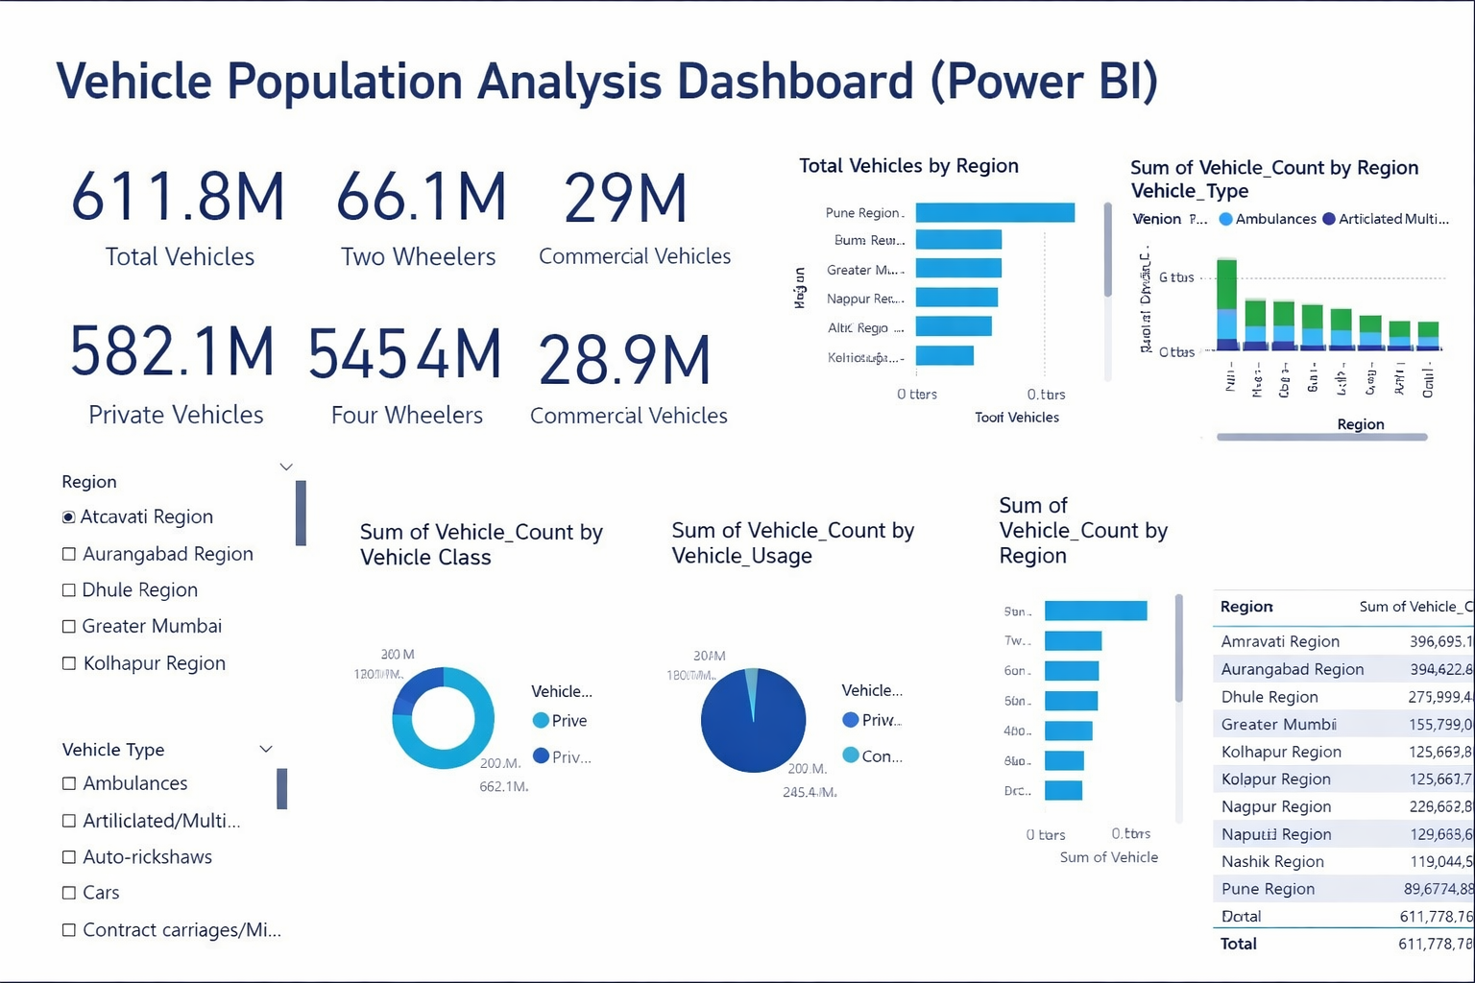
Interactive Power BI Dashboard

Slide 8
Tools Used
• Microsoft Power BI
• Microsoft Excel
• Power Query & DAX
• Microsoft PowerPoint

Slide 9
Conclusion
This project demonstrates how Power BI can transform raw data into meaningful insights to support data-driven decision-making.

Slide 10
Let’s Connect
I am actively seeking Data Analyst / Business Intelligence roles.
Let’s connect to collaborate on data-driven projects.

